Slide 1


Managerial Foundations of Information Systems – Lecture 1
Information Systems in Global Business Today
MFIS
Lisa Murphy

Slide 2

Learning Objectives
To gain an understanding of the following:
Understanding the effects of information systems on business and their relationship to globalization
Explain why information systems are so essential in business today
Define an information system and describe its management, organization, and technology components
Define complementary assets and explain how they ensure that information systems provide genuine value to an organization
Describe the different academic disciplines used to study information systems and explain how each contributes to our understanding of them
Explain what is meant by a socio-technical systems perspective
Notes:
What is globalization? The world revolving – changes in technology, infrastructure, telecommunication
Globalization is affecting virtually every country in the world. The most striking evidence of this trend is the increasing presence of cell phones in the very small villages of Africa. As technology becomes more pervasive and, in some cases easier to use, globalization will continue its steady march. China, Singapore, and Russia are good examples of how globalization has flattened the world. They have become major exporters to other countries, especially industrialized and advanced countries like the U.S. and many European countries. Emerging countries, like Poland, the Ukraine, and Ireland, are excellent examples of increasing globalization.

Slide 3

Scenario
NBA Teams Make a Slam Dunk with Information Technology
Problem
Lack of hard data usable in decision-making processes, costly and competitive market.
Solutions
Developed a new system designed to collect and organize data using video clips of games.
Synergy Sports Technology
Tags video of each game with hundreds of descriptive categories and allows coaches and players to stream game footage from the Web
Demonstrates
IT’s role in innovation and improving business processes
Illustrates
How WWW has allowed businesses to use new tools to analyze critical data
Notes:
3
Ask students to predict whether an NBA team using Synergy Sports Technology would be more successful than a team that did not use the service.
Prompt them to explain why they feel the way they do. You could also ask whether or not they would expect an organization like a professional sports franchise to be a good example of the importance of information systems.
The point here would be that information systems are vitally important to all forms of business, professional sports included.

Slide 4
NBA – Business Challenges
Business Challenges
Develop team strategy
Evaluate players
Coach players
M
Lack of performance statistics
High cost of players
Intense competitive pressure
Management
O
IS
B
Match videos of plays with statistical data
Tag and index plays
organization
Info. Sys
Bus. Solns
T
Analyse player performance
Analyse team performance
Improve performance
Increase revenue
Capture videos
Maintain protected website
Download video to iPods
Technology
Notes:
4

Slide 5
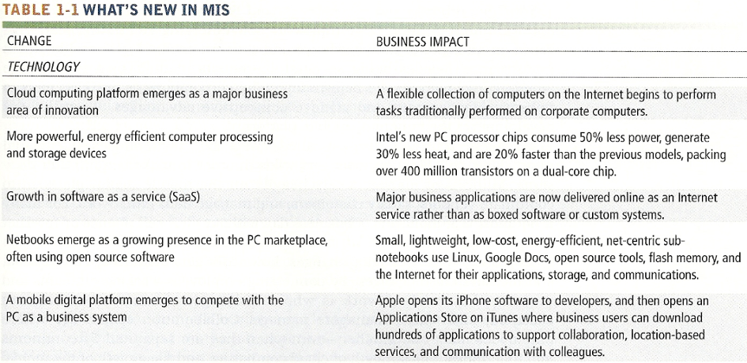
What’s new in MIS
What’s new in MIS - Technology
Technology
Notes:
Ask students what’s new in MIS?
What is Cloud Computing?
Advantages – Saves money, share risk, download applications when you need them, storage

Slide 6
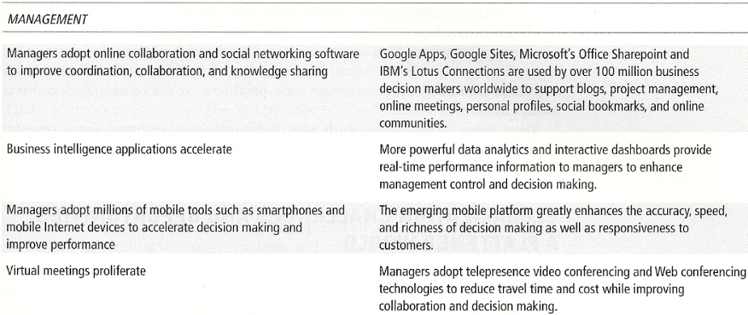
What’s new in MIS
Management

Slide 7
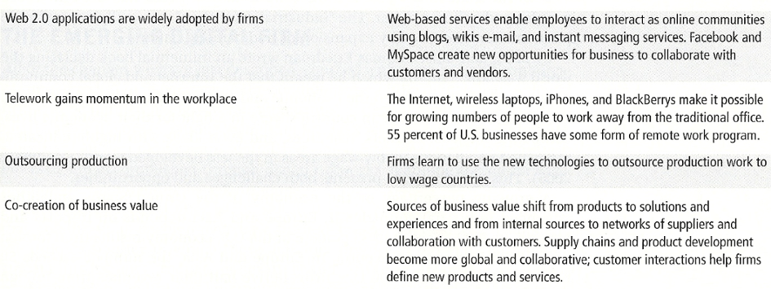
What’s new in MIS - Organizations
Organizations

Slide 8

E xercise 1 – Interactive Session
Q1
What are the advantages of using videoconferencing technologies? What are the disadvantages?
What kinds of companies could benefit from using videoconferencing?
Group Work
Q2
Notes:
Advantages: communicate anywhere, anytime
Disadvantages: connectivity – etc
International companies, news, sports programmes

Slide 9




The Role of Information Systems in Business Today
Business firms invest heavily in information systems to achieve six strategic business objectives:
1. Operational Excellence
4. Improved decision making
2. New Products, services and business models
5. Competitive advantage
3. Customer and supplier intimacy
6. Survival
Notes:
Why does companies invest in IT
Can anyone outline a company who invests heavily on information systems?

Slide 10

The Role of Information Systems in Business Today
1. Operational excellence:
Efficiency, productivity, and improved changes in business practices and management behavior
Improvement of efficiency to attain higher profitability
Information systems, technology an important tool in achieving greater efficiency and productivity
E.g. Wal-Mart’s Retail Link system links suppliers to stores for superior replenishment system – Most efficient retail store in the Industry

Slide 11


The Role of Information Systems in Business Today
2. New products, services, and business models:
Business model: describes how company produces, delivers, and sells product or service to create wealth
Information systems and technology a major enabling tool for new products, services, business models
E.g. Apple’s iPod, iTunes transformed the old business model of music distribution from CDs into online
Netflix’s Internet-based DVD downloads vs rental stores

Slide 12


The Role of Information Systems in Business Today
3. Customer and supplier intimacy:
Serving customers well leads to customers returning, which raises revenues and profits
E.g. High-end hotels that use computers to track customer preferences (room temperature, TV channels) and use IS to monitor and customise environment.. Amazon knowing your taste in Books!
Intimacy with suppliers allows them to provide vital inputs, which lowers costs
E.g. J.C.Penney’s information system which links shirt sales records at each store to contract manufacturer in Hong Kong. Supplier produces (quantity, style, color, size) based on the sales records and delivers directly to stores; no inventory storage costs for J.C.Penney, lower price to customer

Slide 13

Business Today
4. Improved decision-making:
Without accurate information:
Without accurate and timely information, business managers must make decisions based on forecasts,
Leads to:
Overproduction, underproduction of goods and services
Misallocation of resources
Poor response times
Poor outcomes raise costs, lose customers
Verizon’s Web-based digital dashboard to provide managers with real-time data on customer complaints, network performance, line outages, etc.

Slide 14

The Role of Information Systems in Business Today
5. Competitive advantage (doing things better than your competitors!)
Implementing effective and efficient information systems can allow a company to charge less for superior products, adding up to higher sales and profits than their competitors.
Delivering better performance
Charging less for superior products
Responding to customers and suppliers in real time
E.g. Dell: Consistent profitability over 25 years; Dell remains one of the most efficient producer of PCs in world.
But Dell has lost some of its advantages to fast followers– HP (competitive advantage is not sustainable)

Slide 15
The Role of Information Systems in Business Today
6. Survival
Information systems and technologies as a necessity for businesses to survive
Driven by:
Industry-level changes, e.g. the introduction of ATMs by one bank, forces other banks to follow
Governmental regulations
New tax regulation, Introduction of Euro, Data Protection.
Firms need IS capability to respond to these requirements

Slide 16
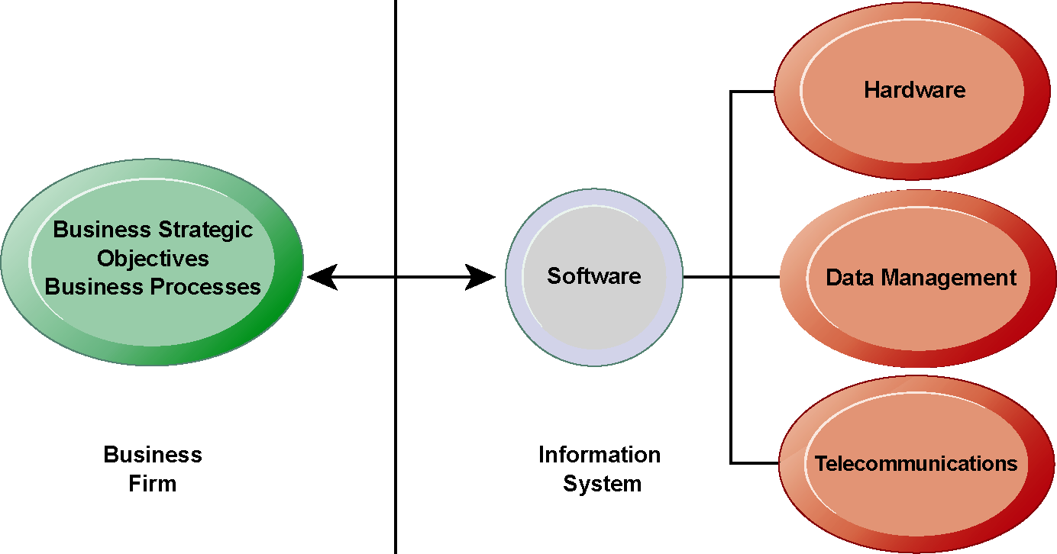
Business and IT Strategy
The link between organizations and Information Technology

Slide 17
E xercise 2 – Match up
1. Operational Excellence | (a) Serving customers well leads to customers returning, which raises revenues and profits
2. New products, services, and business models | (b) Charging less for superior products
3. Customer and supplier intimacy | (c) Information systems and technologies as a necessity for businesses to survive
4. Improved decision-making | (d) Information systems, technology an important tool in achieving greater efficiency and productivity
5. Competitive advantage | (e) Without accurate and timely information, business managers must make decisions based on forecasts
6. Survival | (f) Information systems and technology a major enabling tool for new products, services, business models
Notes:
Match up the six objectives that business firms invest heavily in information systems for:
1 = d
2 = f
3 = a
4 = e
5 = b
6 = c

Slide 18
IS - Activities
Information system: Three activities produce information organizations need
Input
Captures raw data from organization or external environment
Processing
Converts raw data into meaningful form
Output
Transfers processed information to people or activities that use it
Notes:
18
Ask students their age that would represent input, calculating the average age and determining the oldest and youngest age would represent processing, and writing that information on the board would represent output.

Slide 19
IS - Activities
Feedback
Output returned to appropriate members of organization to help evaluate or correct input stage
Computer/Computer program vs. information system
Computers and software are technical foundation and tools, similar to the material and tools used to build a house
Notes:
19
Explain to students that the ‘house’ analogy runs as follows: assuming that a successful information system is like a completed ‘house’, computers and software only represent the tools and materials used to build the house. Tools and materials don’t just suddenly become a completed house – outside (human) input is required. Systems need to be designed to fit the firms and the humans who work with the systems.

Slide 20
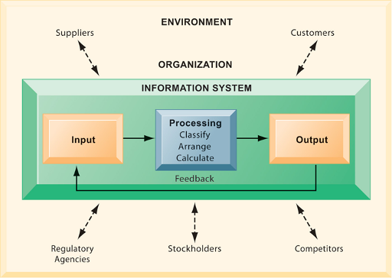
Functions of an IS
An information system contains information about an organization and its surrounding environment. Three basic activities—input, processing, and output—produce the information organizations need. Feedback is output returned to appropriate people or activities in the organization to evaluate and refine the input. Environmental actors, such as customers, suppliers, competitors, stockholders, and regulatory agencies, interact with the organization and its information systems.
Notes:
20
The point of this diagram is first of all to highlight the three basic activities of information systems, so that students can understand what an information system is doing at its most fundamental level. But the diagram also puts information systems into the context of organizations (firms), and then puts the firm into its respective environment composed of shareholders, higher level authorities (government), competitors, suppliers and customers. Suddenly students should see that information systems play a central role mediating and interacting with all these players. Hence, systems play a key role in the operations and survival of the firm.
You could also explain this diagram by relating it back to the opening case, as the book does. The two types of input into the Synergy system are manually entered data as well as video. The system processes that data and creates the output, video and statistics about specific types of players and plays.

Slide 21

Break Time
10 Minutes break!!

Slide 22
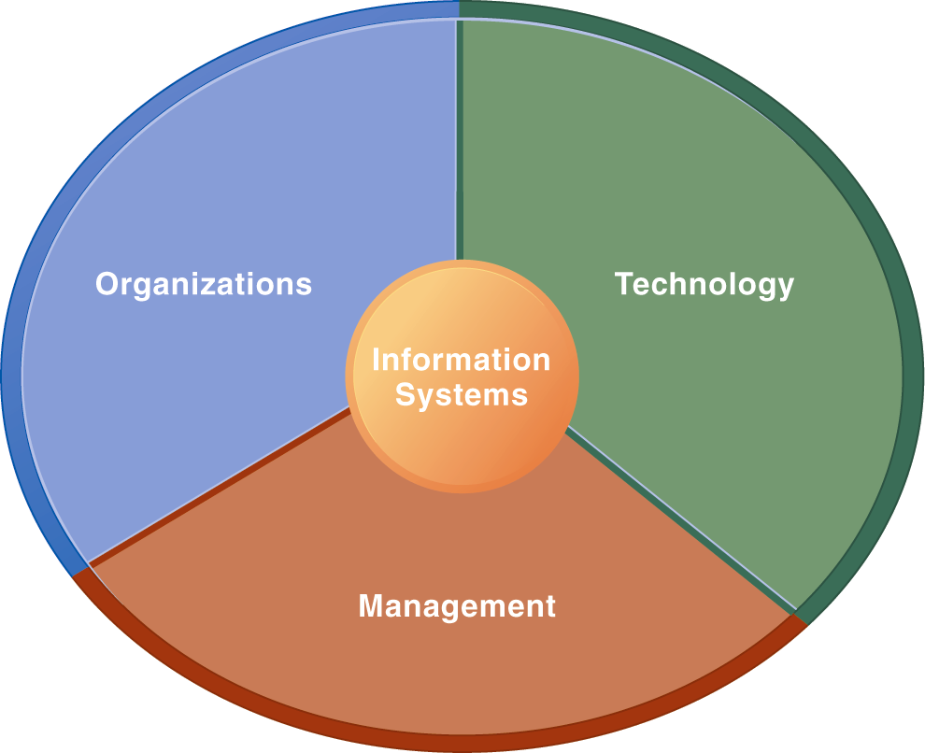
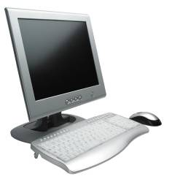
More than a Computer
Using information systems effectively requires an understanding of the organization, management, and information technology shaping the systems. An information system creates value for the firm as an organizational and management solution to challenges posed by the environment.
Notes:
22
These three themes (management, organizations, and technology) will reappear throughout the book. Understanding the interaction between these factors and information systems is known as information system literacy. Knowing how to optimize the relationship between technology, organizations, and management is the purpose of this book and course.

Slide 23

Organization
Organizational dimension of information systems
Hierarchy of authority, responsibility
Senior management
Middle management
Operational management
Knowledge workers
Data workers
Production or service workers
Notes:
23
Page 49 in the text provides more specific details on each level of this hierarchy. You can ask students to talk about an organization where they currently work, or have worked in the past. What was their contact with senior management, middle management, and operational (supervisory) management? Many younger students will have had little or no contact with senior and middle management. Older students most likely will have experience. You might need to provide more description about exactly what senior managers do for the firm (and middle managers).

Slide 24
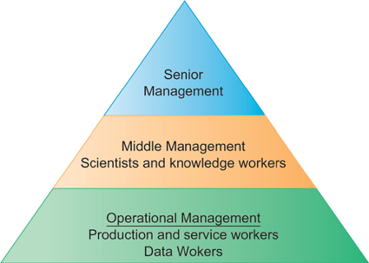
Levels in a Firm
Business organizations are hierarchies consisting of three principal levels: senior management, middle management, and operational management. Information systems serve each of these levels. Scientists and knowledge workers often work with middle management.
Notes:
24
Ask students to think about how information systems would factor into the day-to-day jobs of each of the three types of workers in the pyramid.

Slide 25
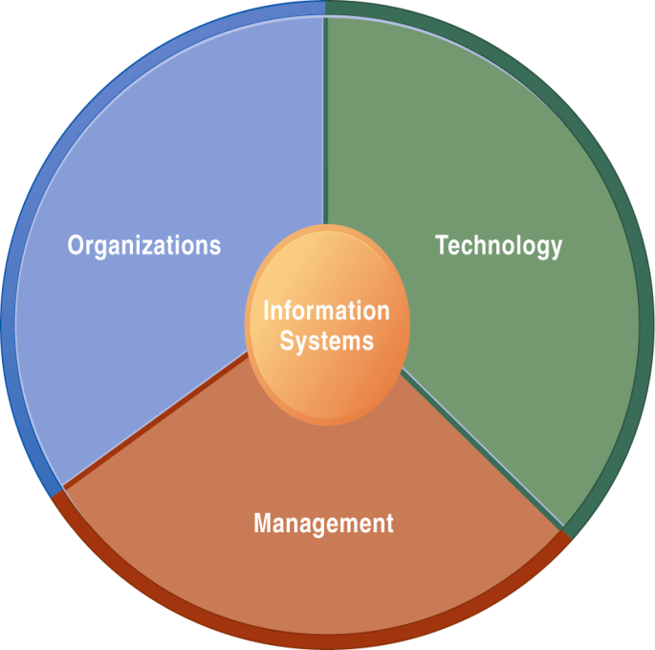
Organization
Organizational dimension of information systems (cont.)
Separation of business functions
Sales and marketing
Human resources
Finance and accounting
Manufacturing and production
Unique business processes
Unique business culture
organizational politics
Notes:
25
The point of this slide is to let students know there are many organizational factors that will shape information systems. A common observation is that “Every business is different.” Does this mean every business will have different information systems? Every business has its unique culture, and politics. Systems reflect these business cultures.
For an example of how information systems shed light on a firm’s unique business processes and culture, you might describe the UPS Interactive Session later in the chapter. The company’s package tracking systems exemplify their commitment to customer service and putting the customer first.

Slide 26
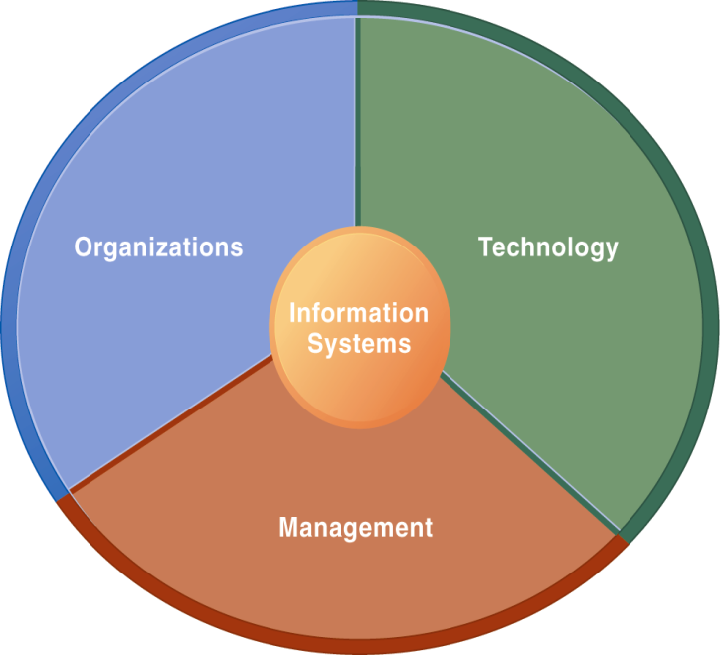
Management
Management dimension of information systems
Managers set organizational strategy for responding to business challenges
In addition, managers must act creatively:
Creation of new products and services
Occasionally re-creating the organization
Notes:
26
How might information systems assist managers in the development of new products and services? What is meant by re-creating the organization? Why do organizations need to be continually re-created? The answer is that they quickly become obsolete unless they continue to change. Ask students to help you list some organizations that have recently failed, or are about to fail.

Slide 27

Technology
Technology dimension of information systems
Computer hardware and software
Data management technology
Networking and telecommunications technology
Networks, the Internet, intranets and extranets, World Wide Web
IT infrastructure: provides platform that system is built on
Notes:
27
Information technology is at the heart of information systems. While organization and management are important too, it’s the technology that enables the systems and the organizations and managers who use the technology.
The distinction between the Internet and intranets & extranets has to do with their scope. Intranets are private networks used by corporations and extranets are similar except that they are directed at external users (like customers and suppliers). In contrast, the Internet connects millions of different networks across the globe. Students may not immediately understand this distinction.

Slide 28
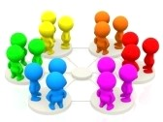

E xercise 3 – UPS competes with Technology
Hand-out
Read the Interactive Session: Technology, and then discuss the following questions:
What are the inputs, processing, and outputs of UPS’s package tracking system?
What technologies are used by UPS? How are these technologies related to UPS’s business strategy?
What problems do UPS’s information systems solve? What would happen if these systems were not available?
Groups of 3

Slide 29

UPS Competes Globally with Information Technology
Dimensions of UPS tracking system
Organizational:
Procedures for tracking packages and managing inventory and provide information
Management:
Monitor service levels and costs
Technology:
Handheld computers, bar-code scanners, networks, desktop computers, etc.
Notes:
29
Discuss what the consequences would be if any one of the three dimensions of information systems were lacking at UPS. With poor technology, good management and organizational procedures would not significantly increase efficiency; without good organizational procedures, even the highest-quality technology wouldn’t prevent frequent errors and data loss; and without good management, the company would not make appropriate decisions about how to use the technology and what procedures to use.

Slide 30

Business
Business perspective on information systems:
Information system is instrument for creating value
Investments in information technology will result in superior returns:
Productivity increases
Revenue increases
Superior long-term strategic positioning
Notes:
30
You could ask students to consider how this view of information systems might contrast with the sociotechnical view or other views. You could also ask them to consider the circumstances under which information systems might not result in increased productivity and revenue.

Slide 31

Value Chain
Business information value chain
Raw data acquired and transformed through stages that add value to that information
Value of information system determined in part by extent to which it leads to better decisions, greater efficiency, and higher profits
Business perspective
Calls attention to organizational and managerial nature of information systems
Notes:
31
During this and the next slide, emphasize that the end result of the business information value chain will always be profitability.
Questions for students: What aspects of the business perspective might be lacking? Are there other perspectives that might provide a different picture? (sociotechnical)

Slide 32
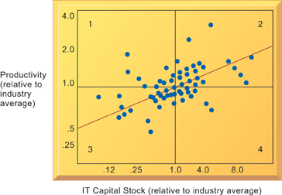
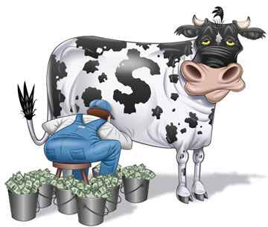
Variation in Returns on Information Technology Investment
On average, investments in information technology produce returns far above those returned by other investments, there is considerable variation across firms.
Notes:
32
Emphasize that each quadrant of the graph represents a different type of firm.
Quadrant 1 represents firms that invest much less in IT but still receive strong returns.
Quadrant 2 represents firms that invest a great deal in IT and receive a great deal in returns.
Quadrant 3 represents firms that invest much less in IT and receive poor returns.
Quadrant 4 represents firms that invest a great deal in IT but receive poor returns.

Slide 33

Return on Investment
Investing in information technology does not guarantee good returns
Considerable variation in the returns firms receive from systems investments
Factors:
Adopting the right business model
Investing in complementary assets (organizational and management capital)
Notes:
33
Connect this slide to the previous slide. Many firms make significant investments in IT for very little benefit to the bottom line. Discuss why companies experience a wide variety of outcomes in their efforts to invest in IT. Consider the factors we use in this book: organizational and management factors.

Slide 34

Complementary Assets
Assets required to derive value from a primary investment
Firms supporting technology investments with investment in complementary assets receive superior returns
E.g.: invest in technology and the people to make it work properly
Notes:
34
The example used in the book for complementary assets is for automobile companies: these companies rely on investments in highways, other roads, gas stations, repair facilities, and so on to maximize the value of their primary investment. Ask students to provide a different example of another company’s or industries complementary assets.

Slide 35
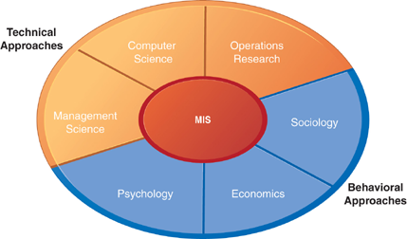
Contemporary Approaches to Information Systems
The study of information systems deals with issues and insights contributed from technical and behavioral disciplines.
Notes:
35
Ask students which of the two major types of approaches, behavioral and technical, they find to be most appropriate or accurate. Why do they feel this way? Emphasize that the technical approach does not ignore behavior and the behavioral approach does not ignore technology, but that they are indeed two distinct approaches.

Slide 36
Different Approaches
Technical approach
Emphasizes mathematically based models
Computer science, management science, operations research
Behavioral approach
Behavioral issues (strategic business integration, implementation, etc.)
Psychology, economics, sociology
Notes:
36
You might ask the students whether they think it’s possible to adopt only one of the two approaches to information systems and be successful. Then emphasize that the most accurate position is that there is no single approach that can truly capture the full scope and importance of information systems by itself.

Slide 37
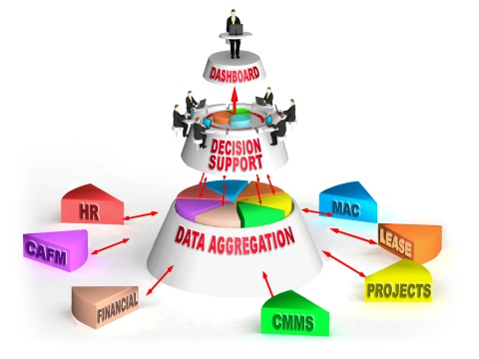
MIS
Management Information Systems
Combines computer science, management science, operations research and practical orientation with behavioral issues
Four main actors
Suppliers of hardware and software
Business firms
Managers and employees
Firm’s environment (legal, social, cultural context)
Notes:
37
Ask students to describe some of the relationships between the four main actors. For example, business firms look to acquire the components of their information systems from suppliers of hardware and software. The firm’s environment may dictate the type of software a company uses as well as the kind of employees that work there.

Slide 38

E xercise 4 – Fill in the Gaps
1. Using information systems effectively requires an understanding of the ____________, _____________, and ______________ shaping the systems.
2. Business organizations are hierarchies consisting of three principal levels: ___________ management, _____________ management, and _____________management.
3. Business firms invest heavily in information systems to achieve six strategic business objectives: _______________, ______________________, ________________________, _________________________, ______________________, _________________________
Notes:
Using information systems effectively requires an understanding of the organization, management, and information technology shaping the systems.
Business organizations are hierarchies consisting of three principal levels: senior management, middle management, and operational management.
Business firms invest heavily in information systems to achieve six strategic business objectives:
1. Operational Excellence
2. New products, services, and business models
3. Customer and supplier intimacy
4. Improved decision-making
5. Competitive advantage
6. Survival

Slide 39

RECAP
To gain an understanding of the following:
Understanding the effects of information systems on business and their relationship to globalization
Explain why information systems are so essential in business today
Define an information system and describe its management, organization, and technology components
Define complementary assets and explain how they ensure that information systems provide genuine value to an organization
Describe the different academic disciplines used to study information systems and explain how each contributes to our understanding of them
Explain what is meant by a socio-technical systems perspective

